Slide 1
A PROJECT
ON
COMPLAIN MANAGEMENT SYSTEM
Project Mentor:- Mr. Deepak Sharma

Slide 2
Project Profile
Project Definition
Complaint Management System provides services for
arrived Complaint of people to municipality.
people can knows the currently processing status of their
Complaints.
All the complaints arrived from people are distributed
to the different departments according to Complaint
category.
Administrator can see all Complaints and Individual
Department Complaints.

Slide 3
Software Requirement:
Operating System : Windows 2007,Ubuntu 15.10 or later version
System Tools : PhpMYSQL Workbench
HTML and CSS : (Front end)
PHP and MS SQL Server 2005 (Back end)

Slide 4
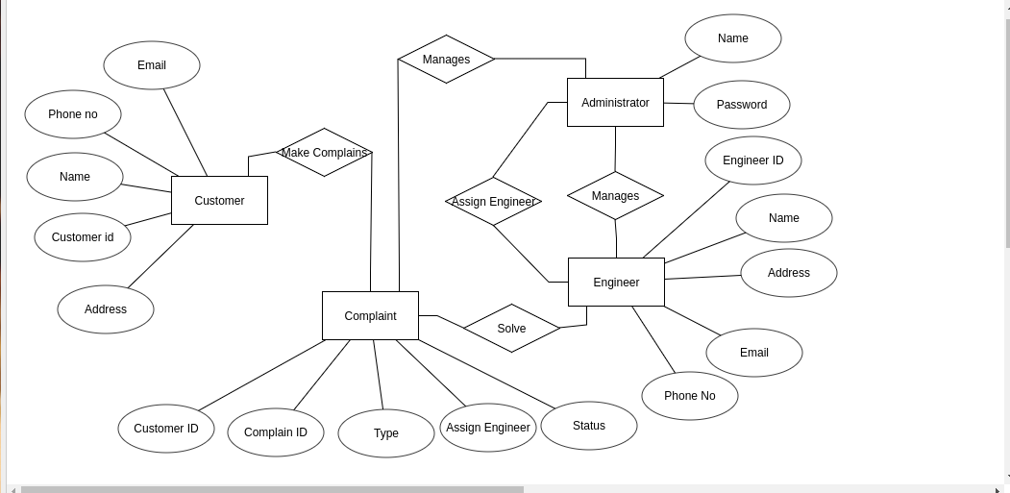
ER DIAGRAM

Slide 5
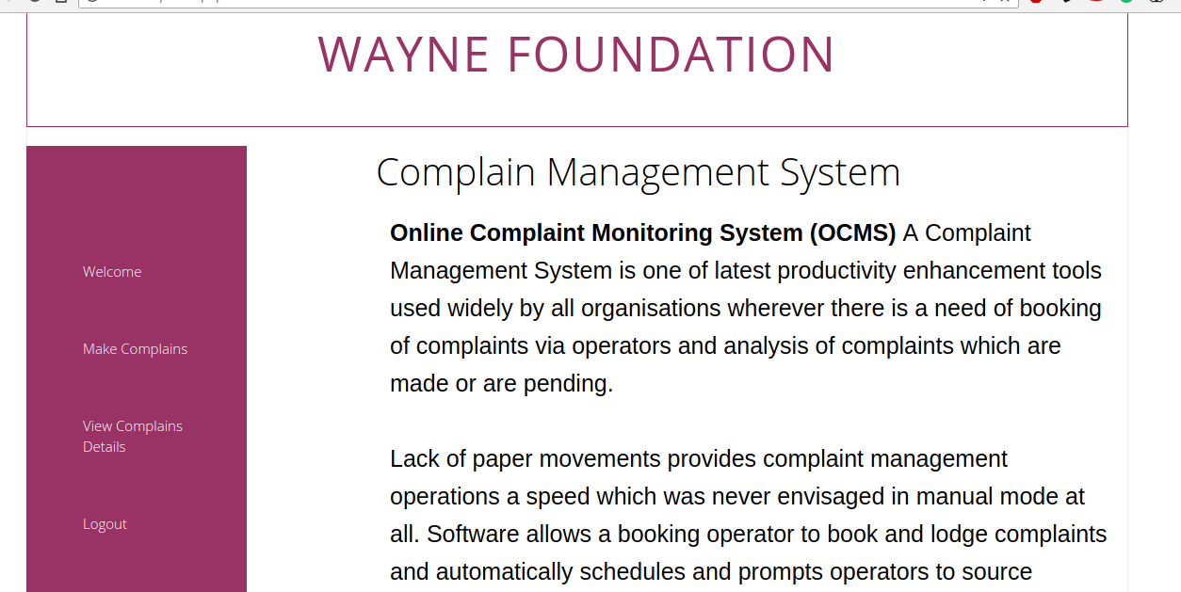
MENU PAGE

Slide 6
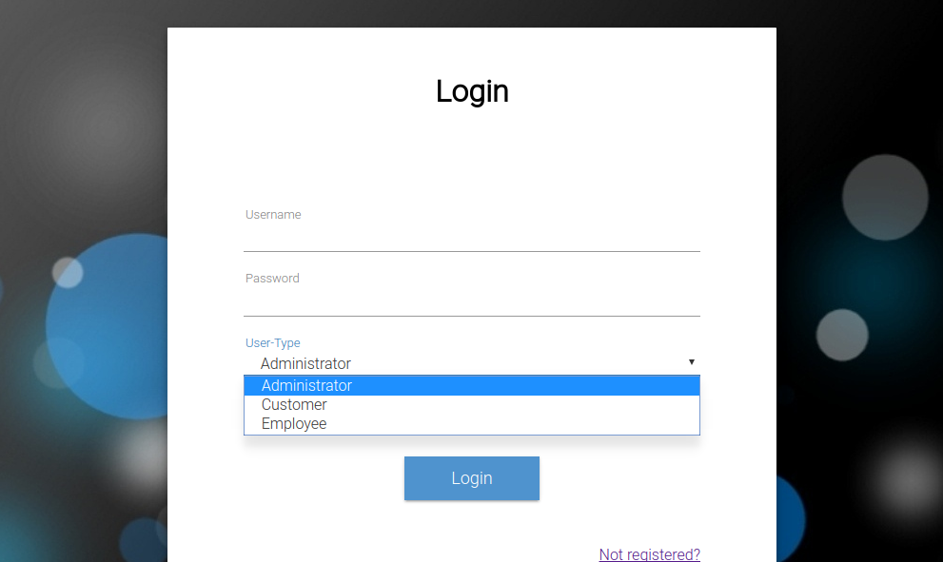

Slide 7
Keys
Superkey in our database is Cid,Cust_id,Eng_id.
Candidate key is Cid for complain_table
Candidate key is Eng_id for Engineer_table

Slide 8
1 NF
1-) The data was repeating initially.
2-) Details of Customer was repeating continuously for every complaint made by the customers thus cause insertion and deletion issue in database.

Slide 9
2 NF
Database is made in a way that there should be no partial dependancy remains ie
No non-prime entity should be accessed from any part of candidate key.

Slide 10
3 NF
Database is finally made in way that there should be
NO Non-Prime to Non-prime entity relationship.
2.) Database finally choose a candidate key in a way that
We avoid any Transition relationship by providing relationships either in Prime to NonPrime entity considering there is no partial dependancy.

Slide 11
Submitted By
Pranjul Tripathi IIT2015094
Prajjawal Aggarwal IIT2015099
Himanshu Gusain IIT2015090
Tushar Muraraka IIT2015091
Shubhanshu Singh LIT2015011

